Slide 1
CSE 417T Introduction to Machine Learning
Lecture 15 Instructor: Chien-Ju (CJ) Ho

Slide 2
Logistics: Homework 4
Homework 4 is due November 14 (Monday)
Keep track of your own late days
Gradescope doesn’t allow separate deadlines
Your submissions won’t be graded if you exceed the late-day limit

Slide 3
Logistics: E-Chapters of LFD
The textbook offers a set of e-chapters
Chap 6: Similarity-Based Methods
Chap 7: Neural Networks
Chap 8: Support Vector Machines
Chap 9: Learning Aides
Appendix B: Linear Algebra
Appendix C: The E-M Algorithm
How to access e-chapters
http://amlbook.com/eChapters.html
”To access the e-Chapters, please download the PDFs and open them with the first word of Chapter 4 as the password. “

Slide 4
Exam 1 Discussion
I plan to grade the exam myself, hopefully in around a week but no more than 2 weeks.

Slide 5
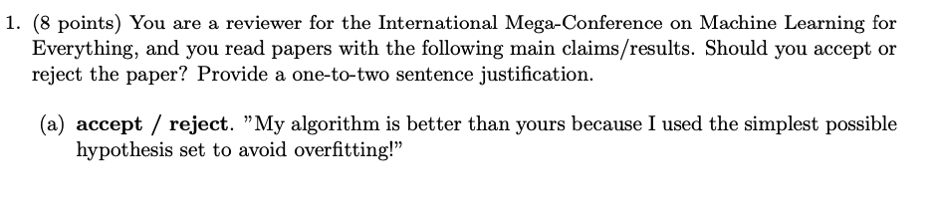
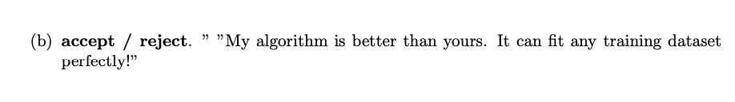
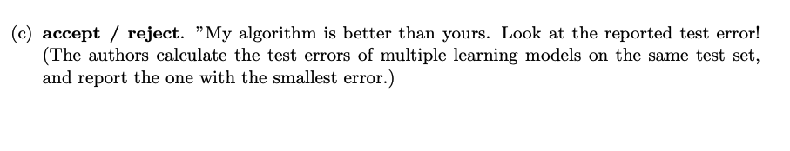
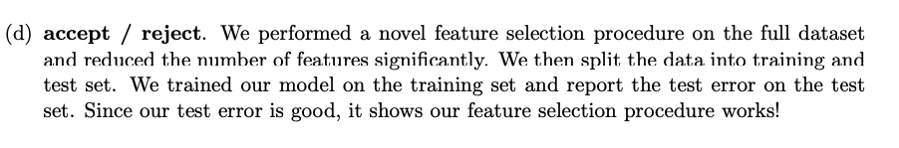

Slide 6
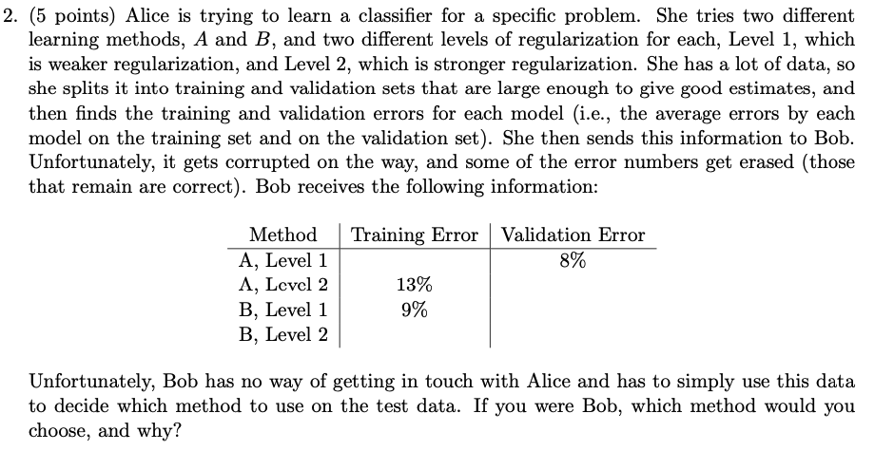

Slide 7
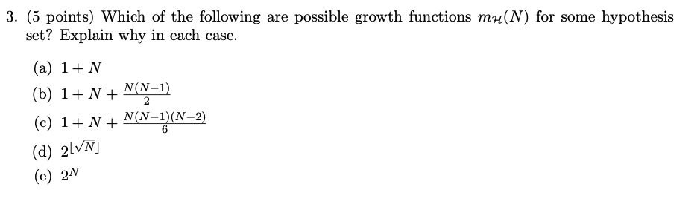
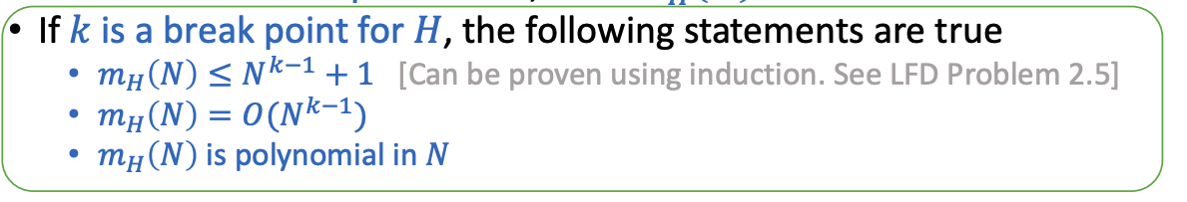

Slide 8
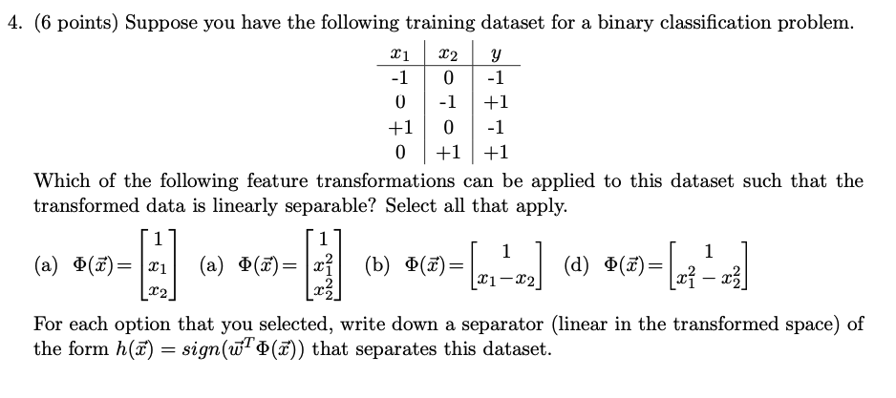

Slide 9
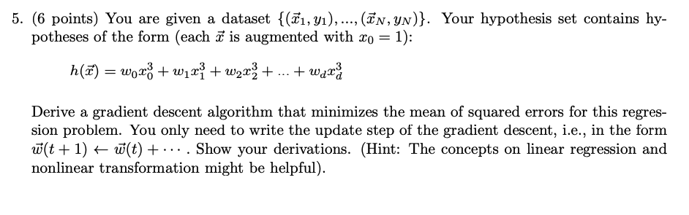
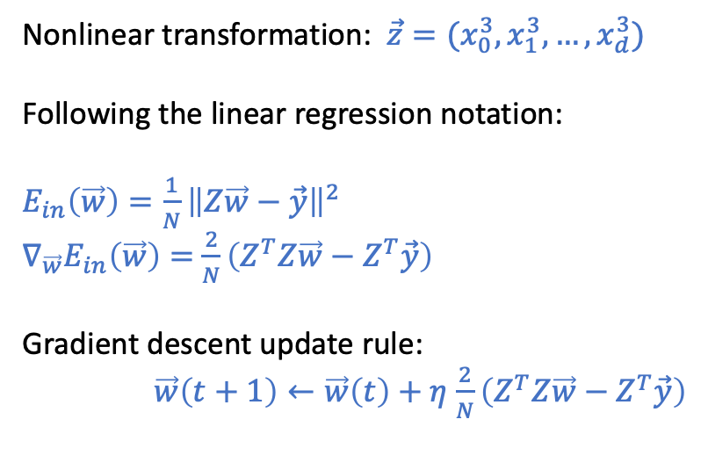
Nonlinear transformation: $\vec{z}=(x_{0}^{3},x_{1}^{3},…,x_{d}^{3})$
Following the linear regression notation:
$E_{in}\left(\vec{w}\right)=\frac{1}{N}{\left\|Z\vec{w}−\vec{y}\right\|}^{2}$
$∇_{\vec{w}}E_{in}\left(\vec{w}\right)=$ $\frac{2}{N}\left(Z^{T}Z\vec{w}−Z^{T}\vec{y}\right)$
Gradient descent update rule:
$\vec{w}\left(t+1\right)←\vec{w}\left(t\right)+η$ $\frac{2}{N}\left(Z^{T}Z\vec{w}−Z^{T}\vec{y}\right)$

Slide 10
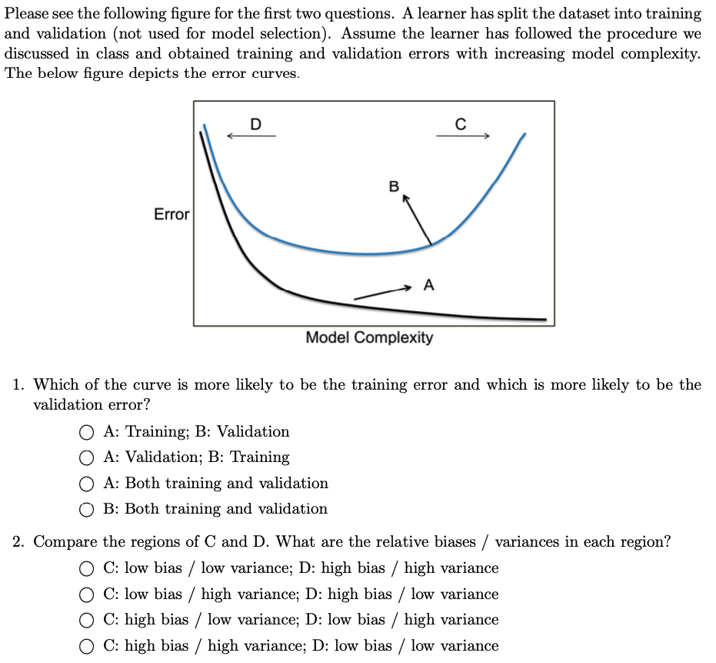

Slide 11
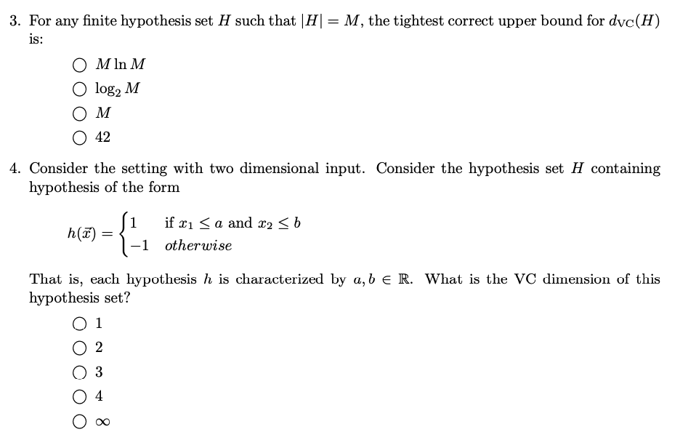

Slide 12
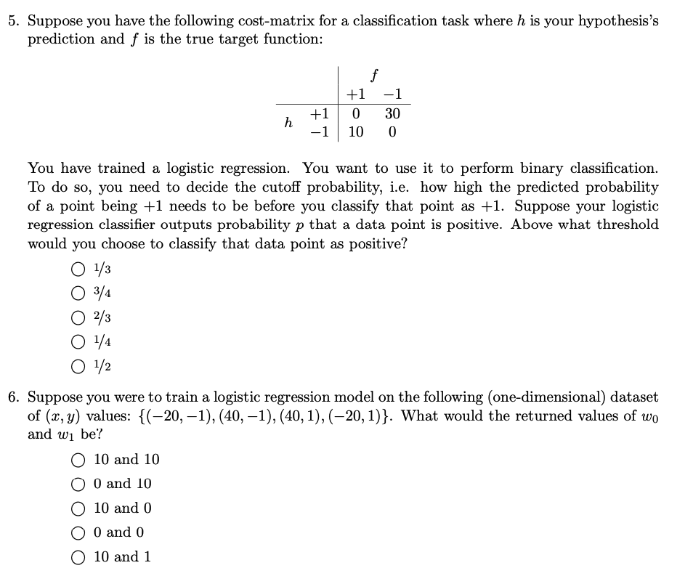

Slide 13
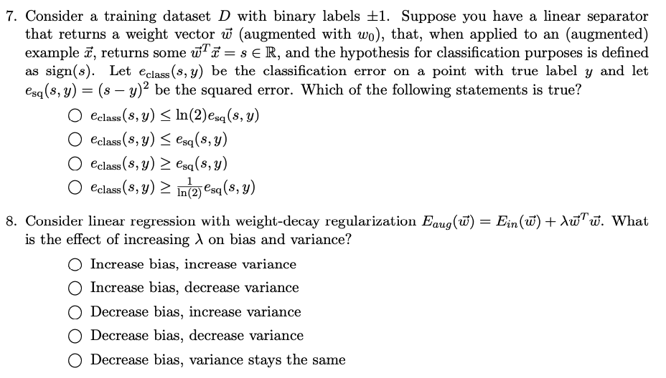

Slide 14
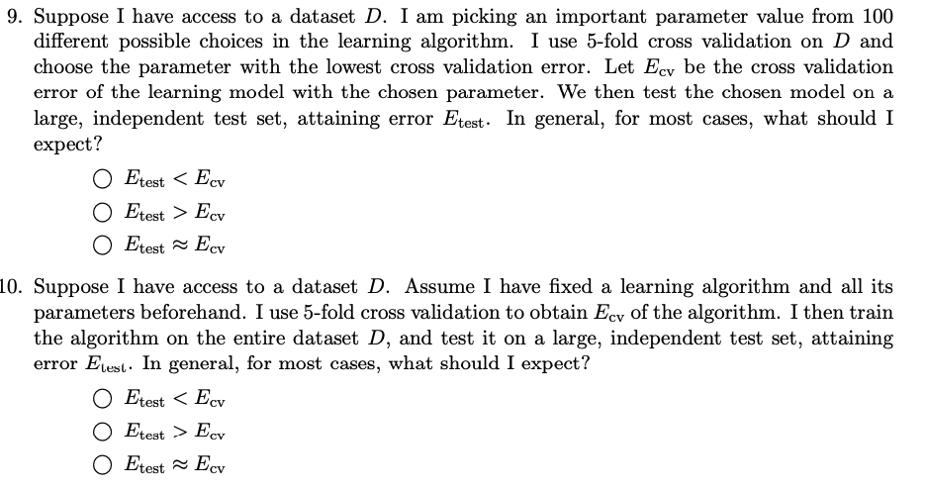

Slide 15
Recap

Slide 16
Ensemble Learning
Goal: Utilize a set of weak learners to obtain a strong learner.
Format of ensemble learning
Construct many diverse weak learners
Aggregate the weak learners
Bagging:
Construct diverse weak learners
(Simultaneously) bootstrapping datasets
Train weak learners on them
Aggregate the weak learners
Uniform aggregation
Boosting
Construct diverse weak learners
Adaptively generating datasets
Train weak learners on them
Aggregate the weak learners
Weighted aggregation

Slide 17
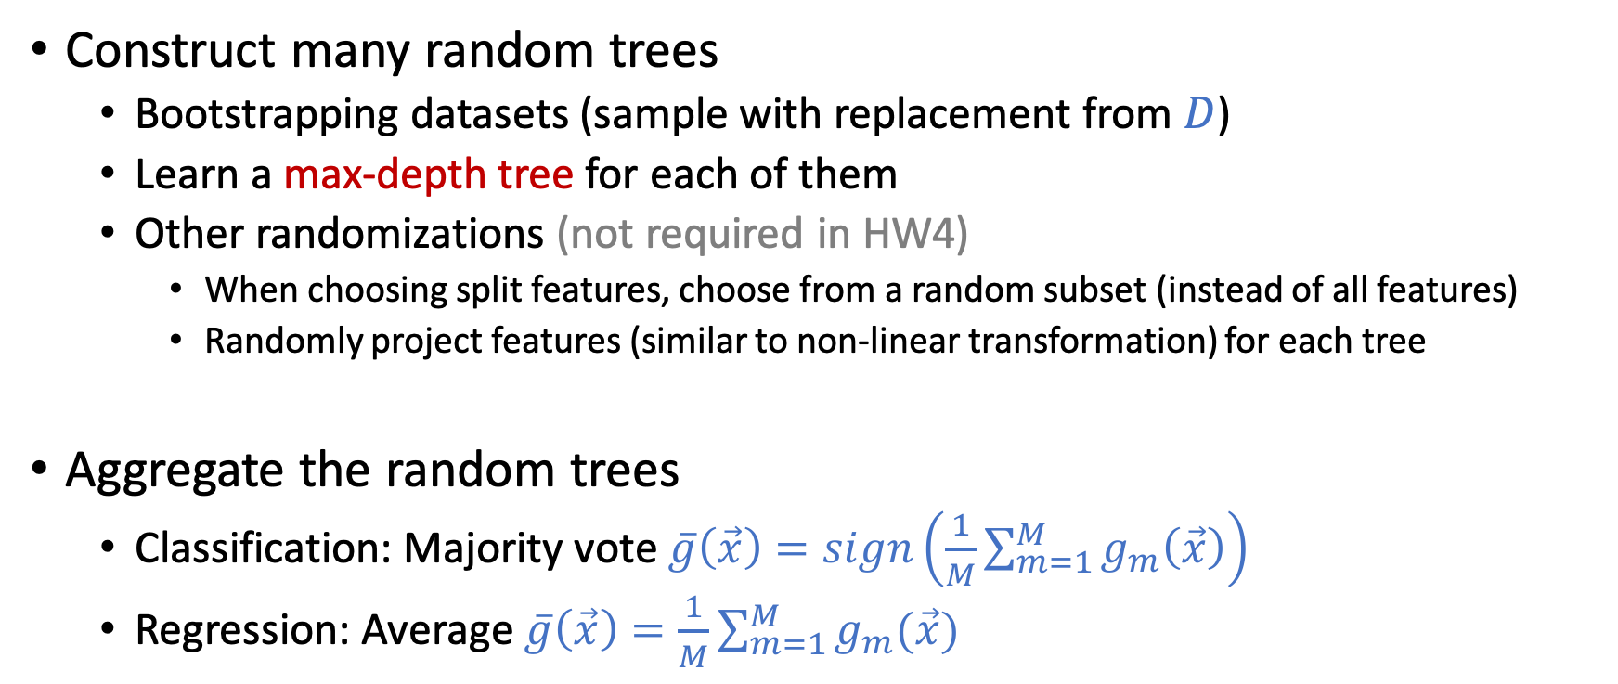
Bagging and Random Forest
Construct many random trees
Bootstrapping datasets (sample with replacement from $D$)
Learn a max-depth tree for each of them
Other randomizations (not required in HW4)
When choosing split features, choose from a random subset (instead of all features)
Randomly project features (similar to non-linear transformation) for each tree
Aggregate the random trees
Classification: Majority vote $\overline{g}\left(\vec{x}\right)=sign\left(\frac{1}{M}\sum_{m=1}^{M}{g_{m}\left(\vec{x}\right)}\right)$
Regression: Average $\overline{g}\left(\vec{x}\right)=\frac{1}{M}\sum_{m=1}^{M}{g_{m}(\vec{x})}$
Note for HW4:
Recommend to transform the labels to +1/-1 for the convenience of aggregation.

Slide 18
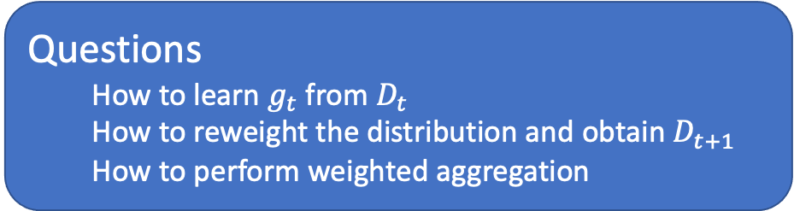
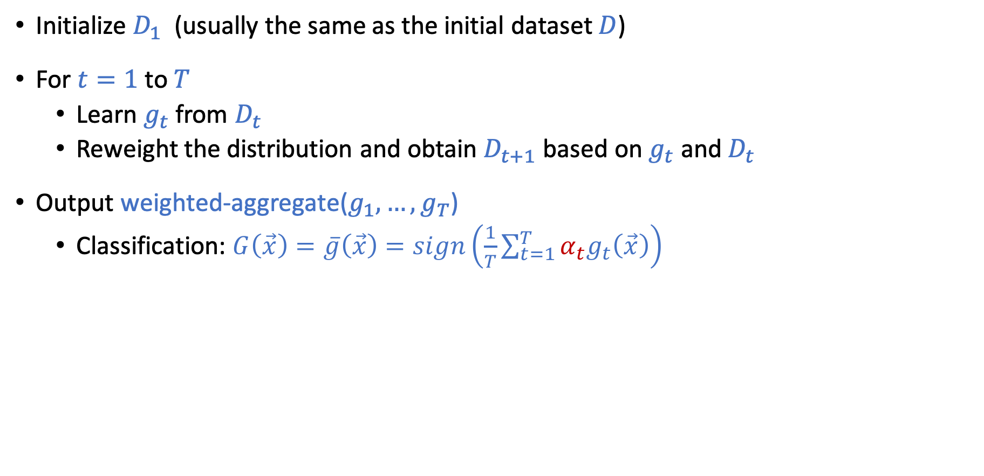
Outline of a Boosting Algorithm
Initialize $D_{1}$ (usually the same as the initial dataset $D$)
For $t=1$ to$T$
Learn $g_{t}$ from $D_{t}$
Reweight the distribution and obtain $D_{t+1}$ based on $g_{t}$ and $D_{t}$
Output weighted-aggregate($g_{1},…,g_{T}$)
Classification: $G\left(\vec{x}\right)=\overline{g}\left(\vec{x}\right)=sign\left(\frac{1}{T}\sum_{t=1}^{T}{α_{t}g_{t}\left(\vec{x}\right)}\right)$
Questions
How to learn $g_{t}$ from $D_{t}$
How to reweight the distribution and obtain $D_{t+1}$
How to perform weighted aggregation

Slide 19
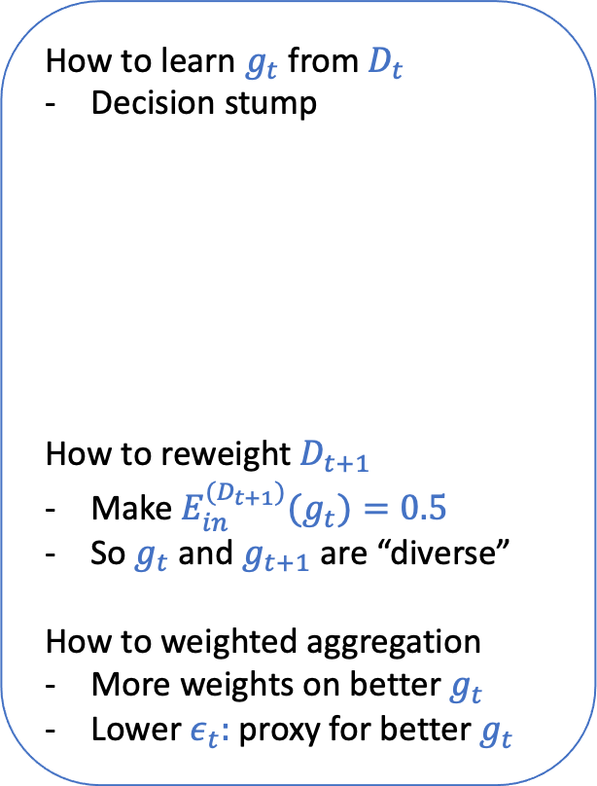
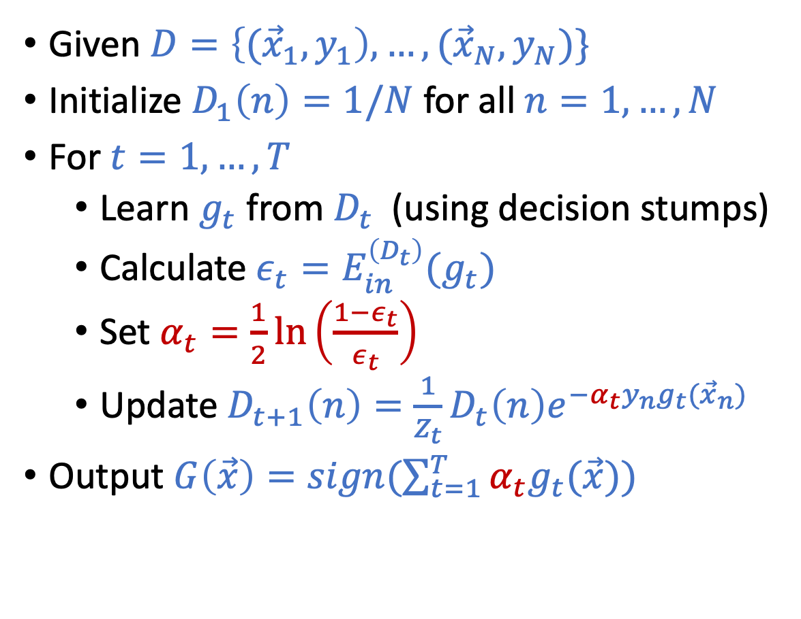
AdaBoost Algorithm
How to learn $g_{t}$ from $D_{t}$
Decision stump
How to reweight $D_{t+1}$
Make ${E_{in}^{(D_{t+1})}(g}_{t})=0.5$
So $g_{t}$ and $g_{t+1}$ are “diverse”
How to weighted aggregation
More weights on better $g_{t}$
Lower $ε_{t}:$ proxy for better $g_{t}$
Given $D=\left\{{(\vec{x}}_{1},y_{1}\right),…,({\vec{x}}_{N},y_{N})\}$
Initialize $D_{1}\left(n\right)=1/N$ for all $n=1,…,N$
For $t=1,…,T$
Learn $g_{t}$ from $D_{t}$ (using decision stumps)
Calculate $ε_{t}=E_{in}^{\left(D_{t}\right)}(g_{t})$
Set $α_{t}=\frac{1}{2}\ln\left(\frac{1−ε_{t}}{ε_{t}}\right)$
Update $D_{t+1}\left(n\right)=\frac{1}{Z_{t}}D_{t}\left(n\right)e^{−α_{t}y_{n}g_{t}({\vec{x}}_{n})}$
Output $G\left(\vec{x}\right)=sign(\sum_{t=1}^{T}{α_{t}g_{t}(\vec{x})})$

Slide 20
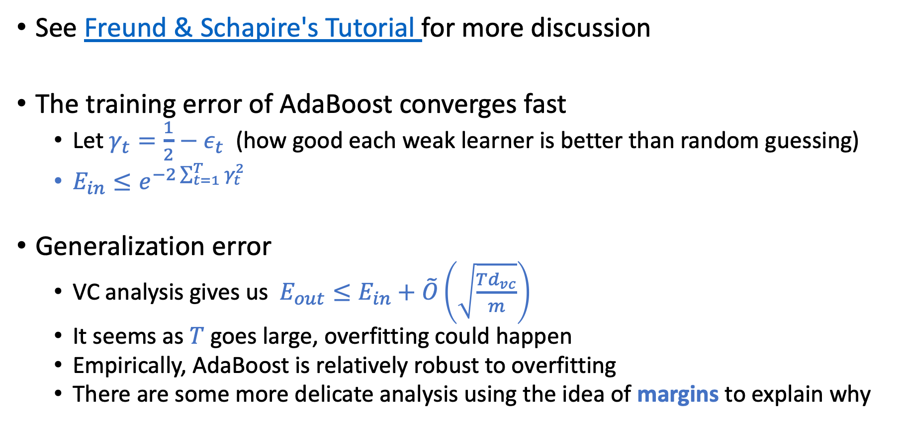
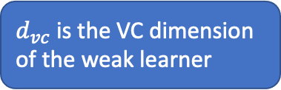
Theoretical Properties of AdaBoost
See Freund & Schapire's Tutorial for more discussion
The training error of AdaBoost converges fast
Let $γ_{t}=\frac{1}{2}−ε_{t}$ (how good each weak learner is better than random guessing)
$E_{in}≤e^{−2\sum_{t=1}^{T}{γ_{t}^{2}}}$
Generalization error
VC analysis gives us $E_{out}≤E_{in}+\tilde{O}\left(\sqrt{\frac{Td_{vc}}{m}}\right)$
It seems as $T$ goes large, overfitting could happen
Empirically, AdaBoost is relatively robust to overfitting
There are some more delicate analysis using the idea of margins to explain why
$d_{vc}$ is the VC dimension of the weak learner

Slide 21
Lecture Notes Today
The notes are not intended to be comprehensive. They should be accompanied by lectures and/or textbook.
Let me know if you spot errors.

Slide 22
Brief Discussion on Gradient Boosting
Gradient boosting is safe to skip for Exam 2

Slide 23
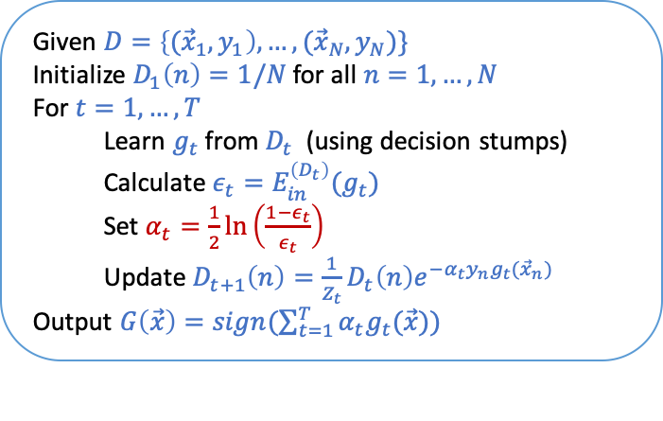
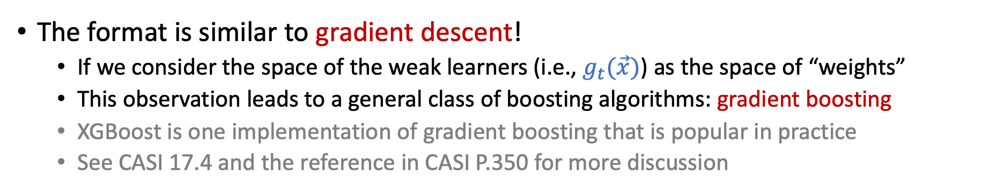
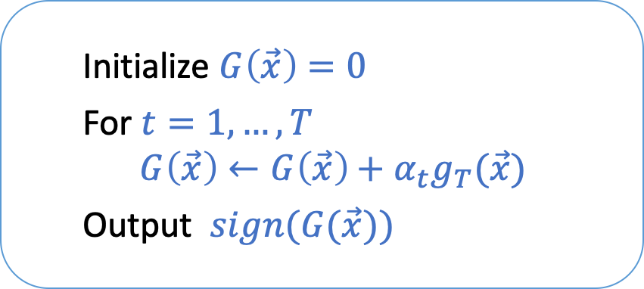
Look at the AdaBoost Algorithm Again
Given $D=\left\{{(\vec{x}}_{1},y_{1}\right),…,({\vec{x}}_{N},y_{N})\}$
Initialize $D_{1}\left(n\right)=1/N$ for all $n=1,…,N$
For $t=1,…,T$
Learn $g_{t}$ from $D_{t}$ (using decision stumps)
Calculate $ε_{t}=E_{in}^{\left(D_{t}\right)}(g_{t})$
Set $α_{t}=\frac{1}{2}\ln\left(\frac{1−ε_{t}}{ε_{t}}\right)$
Update $D_{t+1}\left(n\right)=\frac{1}{Z_{t}}D_{t}\left(n\right)e^{−α_{t}y_{n}g_{t}({\vec{x}}_{n})}$
Output $G\left(\vec{x}\right)=sign(\sum_{t=1}^{T}{α_{t}g_{t}(\vec{x})})$
Initialize $G\left(\vec{x}\right)=0$
For $t=1,…,T$
$$G\left(\vec{x}\right)←G\left(\vec{x}\right)+α_{t}g_{T}(\vec{x})$$
Output $sign(G(\vec{x}))$
The format is similar to gradient descent!
If we consider the space of the weak learners (i.e., $g_{t}(\vec{x})$) as the space of “weights”
This observation leads to a general class of boosting algorithms: gradient boosting
XGBoost is one implementation of gradient boosting that is popular in practice
See CASI 17.4 and the reference in CASI P.350 for more discussion
[Safe to Skip]

Slide 24
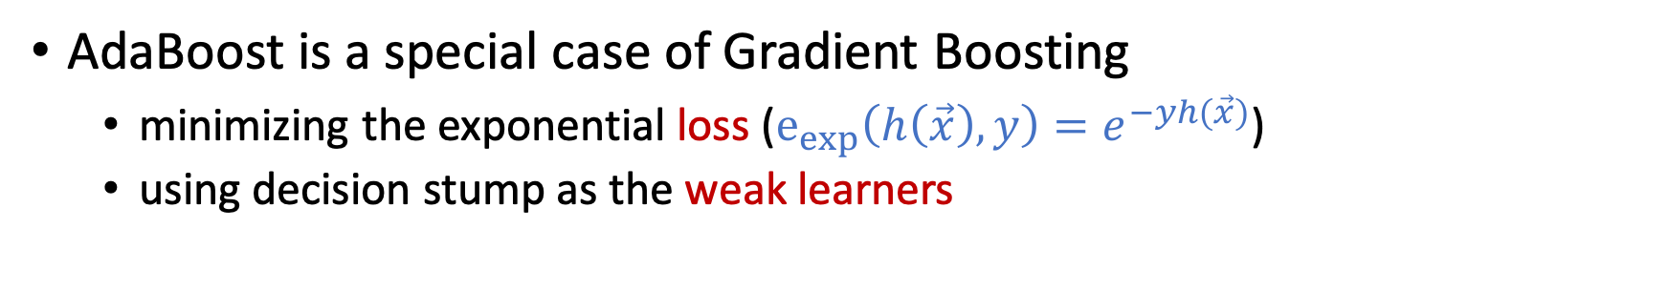
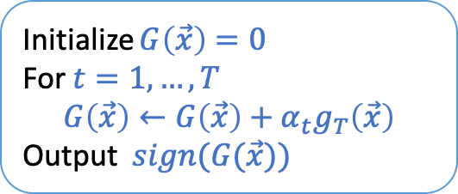
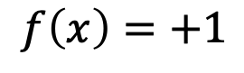
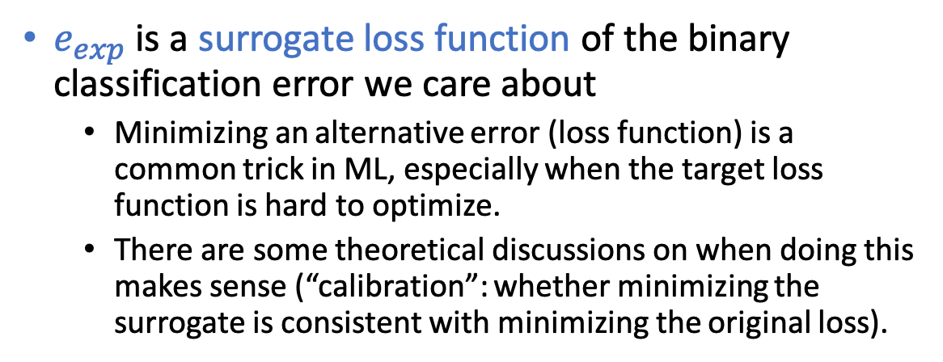
Gradient Boosting
Initialize $G\left(\vec{x}\right)=0$
For $t=1,…,T$
$$G\left(\vec{x}\right)←G\left(\vec{x}\right)+α_{t}g_{T}\left(\vec{x}\right)$$
Output $sign(G(\vec{x}))$
AdaBoost is a special case of Gradient Boosting
minimizing the exponential loss ($e_{exp}\left(h\left(\vec{x}\right),y\right)=e^{−yh(\vec{x})}$)
using decision stump as the weak learners
$$f\left(x\right)=+1$$
$e_{exp}$ is a surrogate loss function of the binary classification error we care about
Minimizing an alternative error (loss function) is a common trick in ML, especially when the target loss function is hard to optimize.
There are some theoretical discussions on when doing this makes sense (“calibration”: whether minimizing the surrogate is consistent with minimizing the original loss).
[Safe to Skip]

Slide 25
Similarity-Based Method: Nearest Neighbor

Slide 26
Movie Rating Prediction
Below is the historical movie ratings from users (5 is the highest)
What do you think Bob’s rating will be for Movie 6?
Maybe 2, since Bob’s taste seems to be similar with Alice’s
 | Movie 1 | Movie 2 | Movie 3 | Movie 4 | Movie 5 | Movie 6
Alice | 5 | 4 | 3 | 1 | 5 | 2
Bob | 4 | 5 | 3 | 2 | 5
Charlie | 1 | 2 | 4 | 4 | 2 | 3
David | 2 | 3 | 2 | 4 | 4 | 4
…

Slide 27
Movie Recommendation
Below is the historical movie ratings from users (5 is the highest)
Which movie will you recommend to Alice, why?
Maybe Movie 5, since Bob’s taste seems to be similar with Alice’s
 | Movie 1 | Movie 2 | Movie 3 | Movie 4 | Movie 5 | Movie 6
Alice | 5 | 4 |  | 1
Bob | 4 |  |  | 2 | 5
Charlie | 1 |  | 4 |  | 2
David |  | 3 | 2 |  |  | 4
…

Slide 28
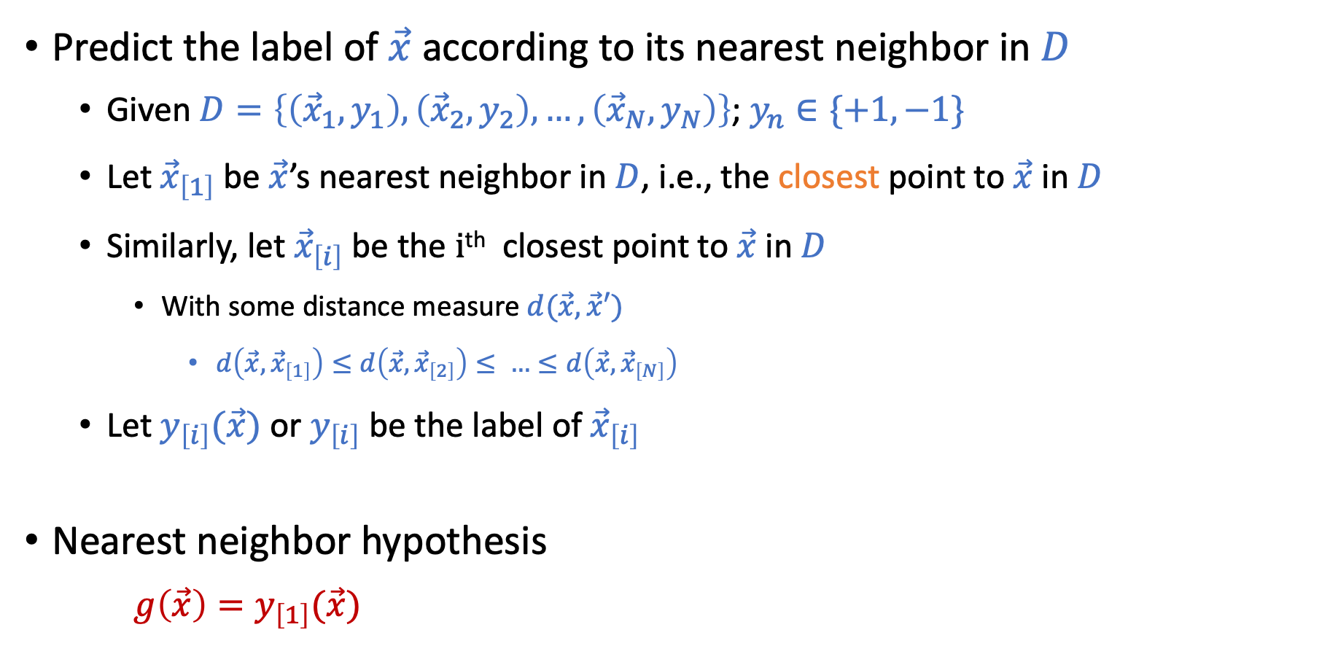
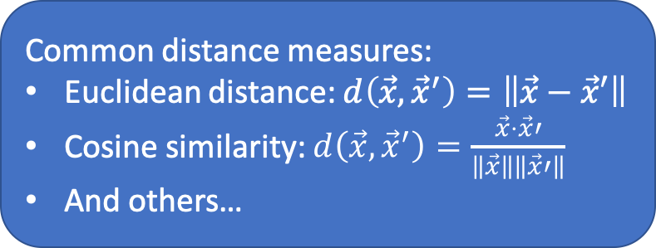
Nearest Neighbor
Predict the label of $\vec{x}$ according to its nearest neighbor in $D$
Given $D=\left\{\left({\vec{x}}_{1},y_{1}\right),\left({\vec{x}}_{2},y_{2}\right),…,\left({\vec{x}}_{N},y_{N}\right)\right\}$; $y_{n}∈\{+1,−1\}$
Let ${\vec{x}}_{\left[1\right]}$ be $\vec{x}$’s nearest neighbor in $D$, i.e., the closest point to $\vec{x}$ in $D$
Similarly, let ${\vec{x}}_{\left[i\right]}$ be the i^{th} closest point to $\vec{x}$ in $D$
With some distance measure $d(\vec{x},\vec{x}′)$
$d\left(\vec{x},{\vec{x}}_{\left[1\right]}\right)≤d\left(\vec{x},{\vec{x}}_{\left[2\right]}\right)≤ …≤d\left(\vec{x},{\vec{x}}_{\left[N\right]}\right)$
Let $y_{\left[i\right]}(\vec{x})$ or $y_{\left[i\right]}$ be the label of ${\vec{x}}_{\left[i\right]}$
Nearest neighbor hypothesis $g\left(\vec{x}\right)=y_{\left[1\right]}(\vec{x})$
Common distance measures:
Euclidean distance: $d\left(\vec{x},{\vec{x}}^{′}\right)=\left\|\vec{x}−\vec{x}′\right\|$
Cosine similarity: $d\left(\vec{x},{\vec{x}}^{′}\right)=\frac{\vec{x}⋅\vec{x}′}{\left\|\vec{x}\right\|\left\|\vec{x}′\right\|}$
And others…

Slide 29
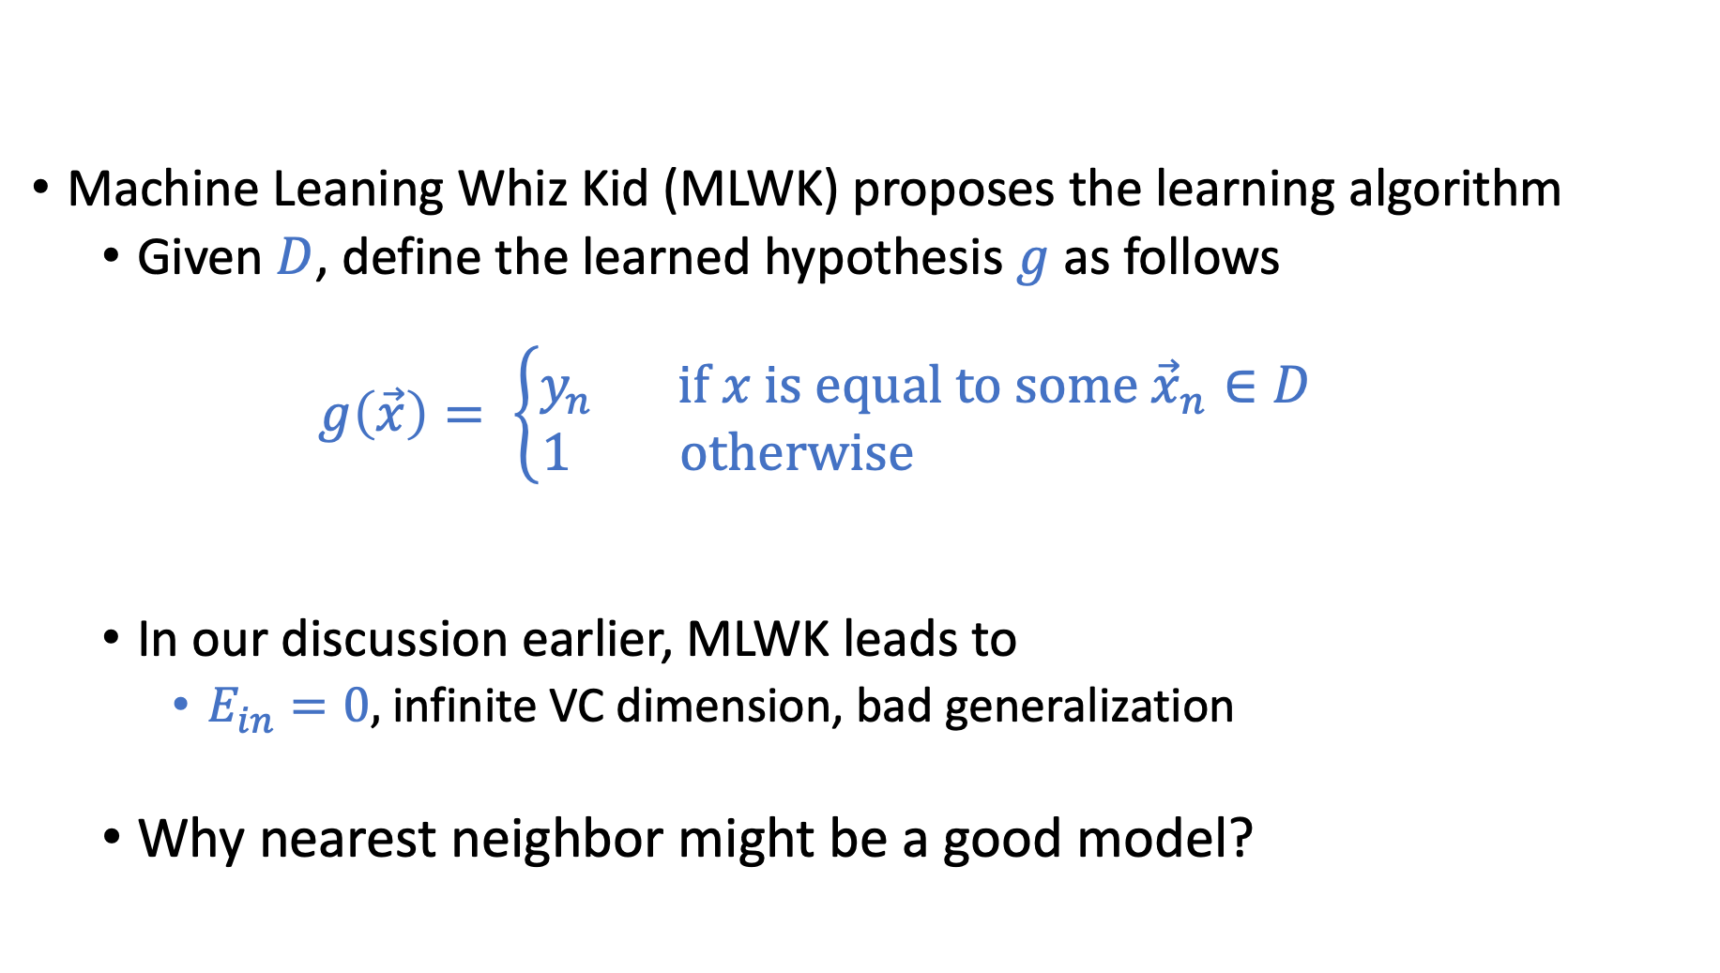
Wait…. in the practice question of exam 1
Machine Leaning Whiz Kid (MLWK) proposes the learning algorithm
Given $D$, define the learned hypothesis $g$ as follows $g\left(\vec{x}\right)= \left\{\begin{aligned}y_{n} \text{if} x \text{is} \text{equal} \text{to} \text{some} {\vec{x}}_{n}∈D \\ 1 \text{otherwise} \end{aligned}\right.$
In our discussion earlier, MLWK leads to
$E_{in}=0,$infinite VC dimension, bad generalization
Why nearest neighbor might be a good model?

Slide 30
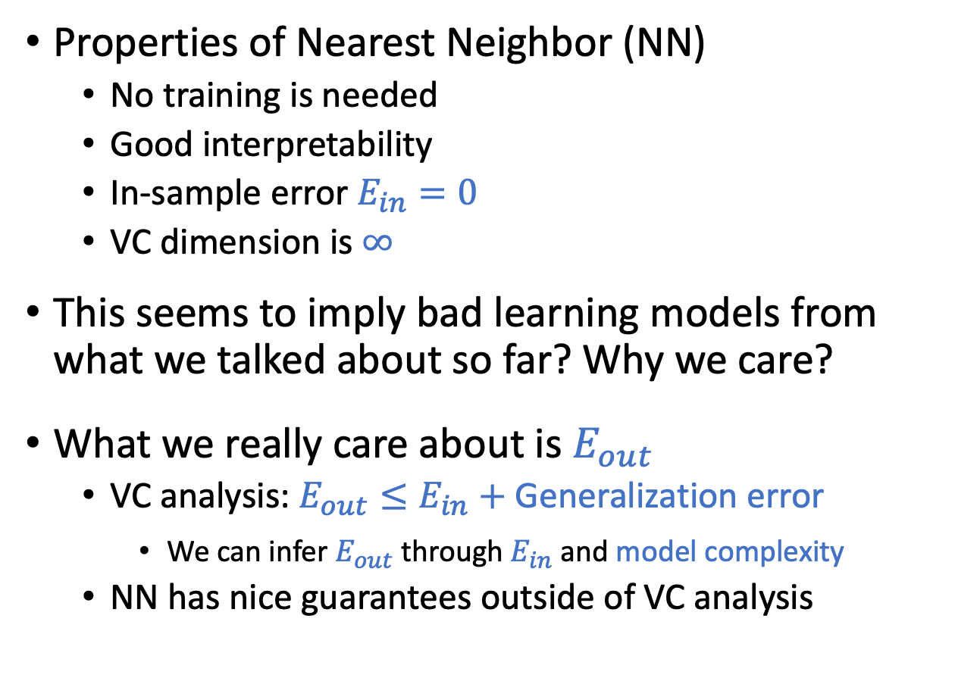
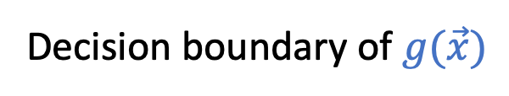
Nearest Neighbor
Properties of Nearest Neighbor (NN)
No training is needed
Good interpretability
In-sample error $E_{in}=0$
VC dimension is $∞$
This seems to imply bad learning models from what we talked about so far? Why we care?
What we really care about is $E_{out}$
VC analysis: $E_{out}≤E_{in}+$ Generalization error
We can infer $E_{out}$ through $E_{in}$ and model complexity
NN has nice guarantees outside of VC analysis
Decision boundary of $g(\vec{x})$

Slide 31
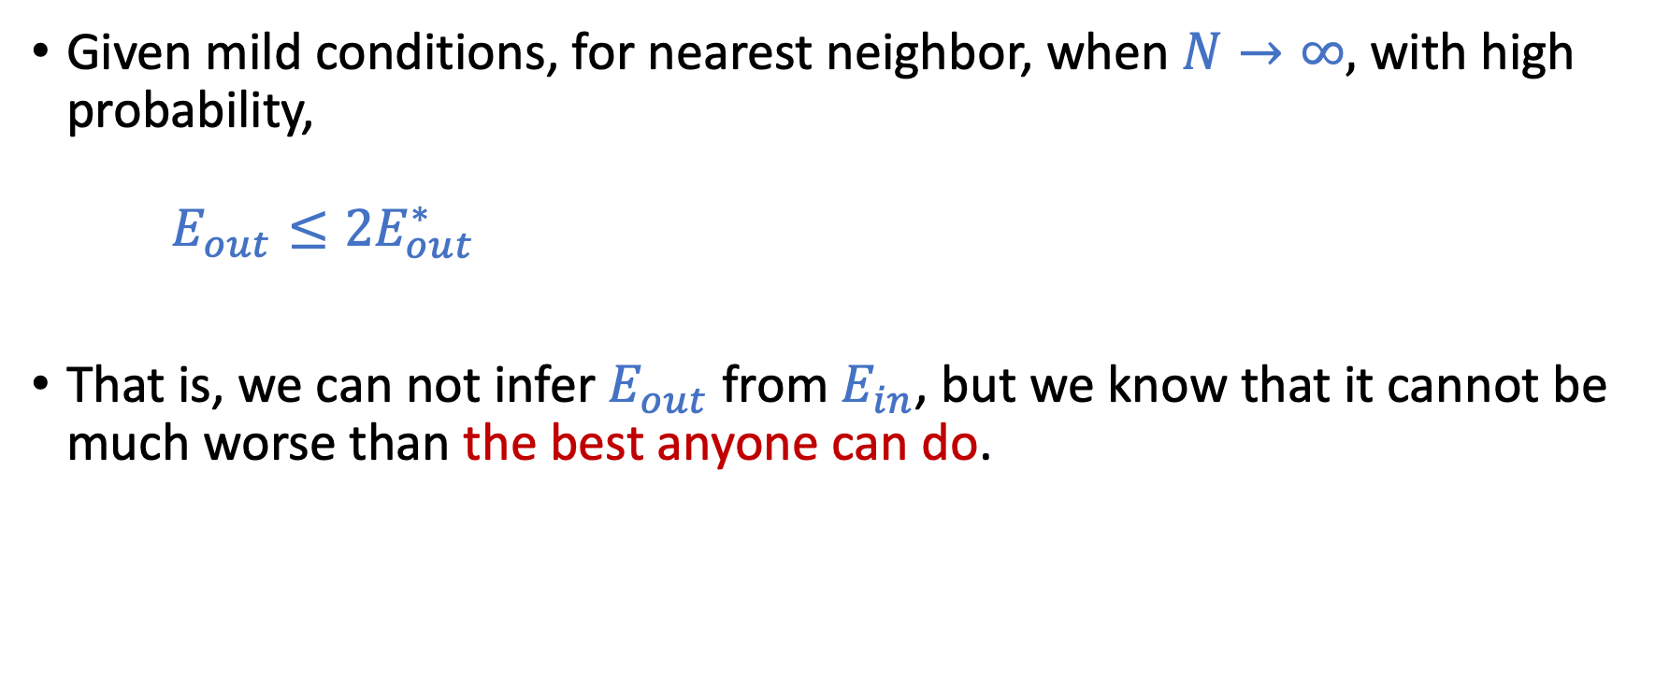
Nearest Neighbor is 2-Optimal
Given mild conditions, for nearest neighbor, when $N→∞,$ with high probability, $E_{out}≤2E_{out}^{∗}$
That is, we can not infer $E_{out}$ from $E_{in}$, but we know that it cannot be much worse than the best anyone can do.

Slide 32
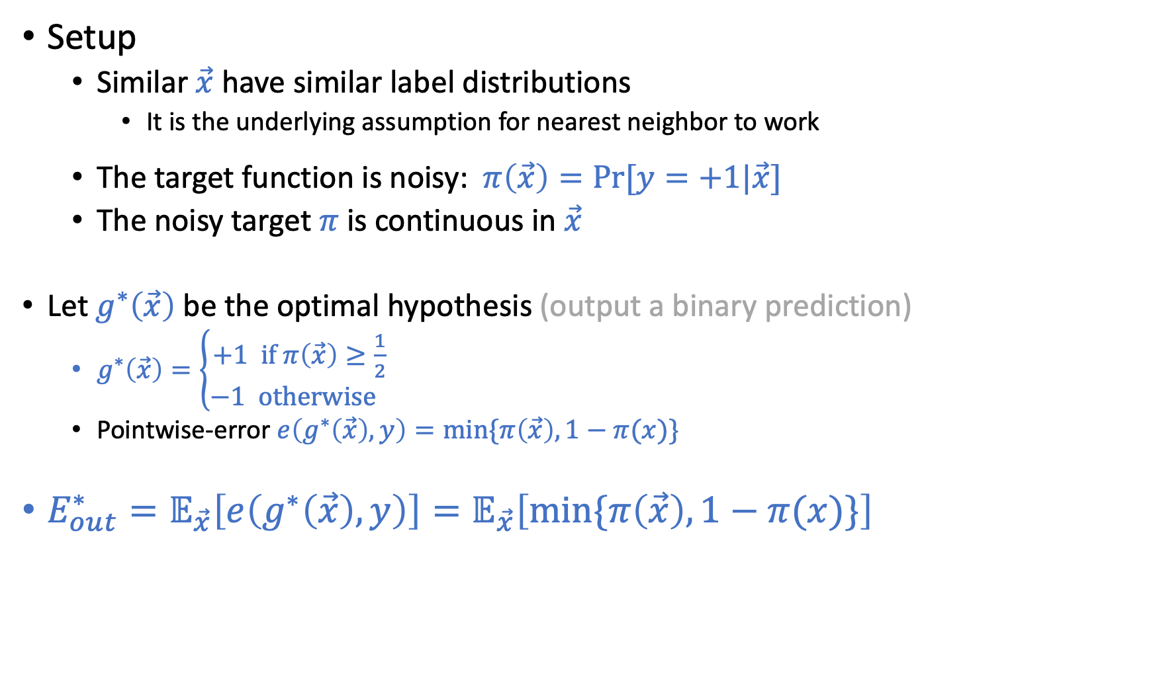
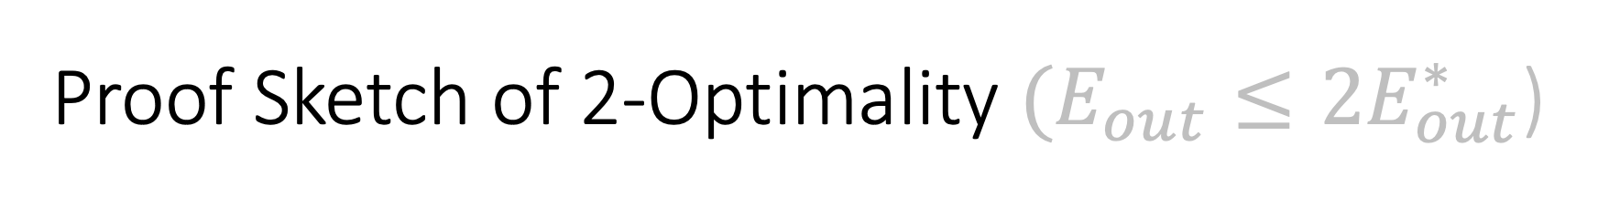
Proof Sketch of 2-Optimality $(E_{out}≤2E_{out}^{∗}$)
Setup
Similar $\vec{x}$ have similar label distributions
It is the underlying assumption for nearest neighbor to work
The target function is noisy: $π\left(\vec{x}\right)=Pr⁡[y=+1|\vec{x}]$
The noisy target $π$ is continuous in $\vec{x}$
Let $g^{∗}\left(\vec{x}\right)$ be the optimal hypothesis (output a binary prediction)
$g^{∗}\left(\vec{x}\right)=\left\{\begin{aligned}+1 \text{if} π\left(\vec{x}\right)≥\frac{1}{2} \\ −1 \text{otherwise} \end{aligned}\right.$
Pointwise-error $e\left(g^{∗}\left(\vec{x}\right),y\right)=min⁡\{π\left(\vec{x}\right),1−π(x)\}$
$E_{out}^{∗}=𝔼_{\vec{x}}\left[e\left(g^{∗}\left(\vec{x}\right),y\right)\right]=𝔼_{\vec{x}}\left[min⁡\{π\left(\vec{x}\right),1−π(x)\}\right]$

Slide 33
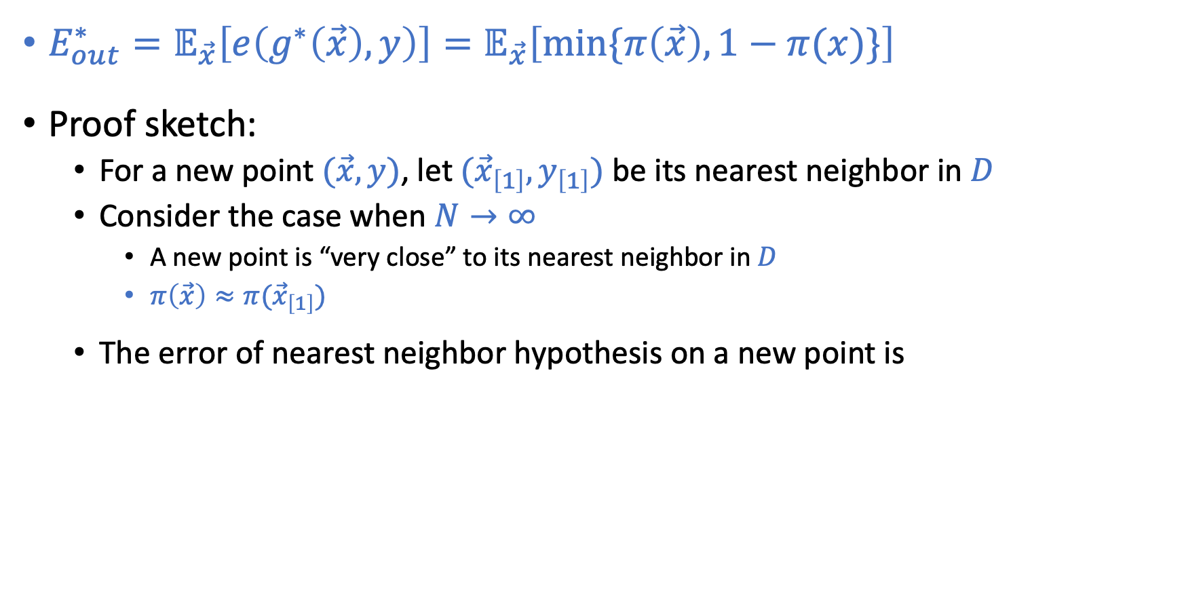
Proof Sketch of 2-Optimality
$E_{out}^{∗}=𝔼_{\vec{x}}\left[e\left(g^{∗}\left(\vec{x}\right),y\right)\right]=𝔼_{\vec{x}}\left[min⁡\{π\left(\vec{x}\right),1−π(x)\}\right]$
Proof sketch:
For a new point $(\vec{x},y)$, let $({\vec{x}}_{\left[1\right]},y_{\left[1\right]})$ be its nearest neighbor in $D$
Consider the case when $N→∞$
A new point is “very close” to its nearest neighbor in $D$
$π\left(\vec{x}\right)≈π({\vec{x}}_{\left[1\right]})$
The error of nearest neighbor hypothesis on a new point is
$\operatorname{Pr}{[y≠y_{\left[1\right]}]}=\operatorname{Pr}\left[y=+1,y_{\left[1\right]}=−1\right]+\operatorname{Pr}\left[y=−1,y_{\left[1\right]}=+1\right]$
$\operatorname{Pr}{[y≠y_{\left[1\right]}]}=π\left(\vec{x}\right)\left(1−π\left({\vec{x}}_{\left[1\right]}\right)\right)+\left(1−π\left(\vec{x}\right)\right)π\left({\vec{x}}_{\left[1\right]}\right)$
$\operatorname{Pr}{[y≠y_{\left[1\right]}]}≈2 π\left(\vec{x}\right)\left(1−π\left(\vec{x}\right)\right)$
$\operatorname{Pr}{[y≠y_{\left[1\right]}]}≤2min⁡\{π\left(\vec{x}\right),1−π\left(\vec{x}\right)\}$

Slide 34
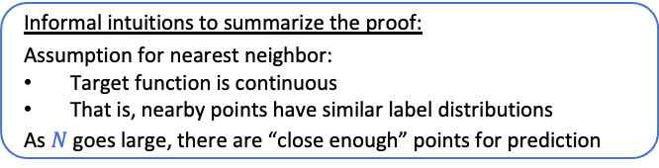
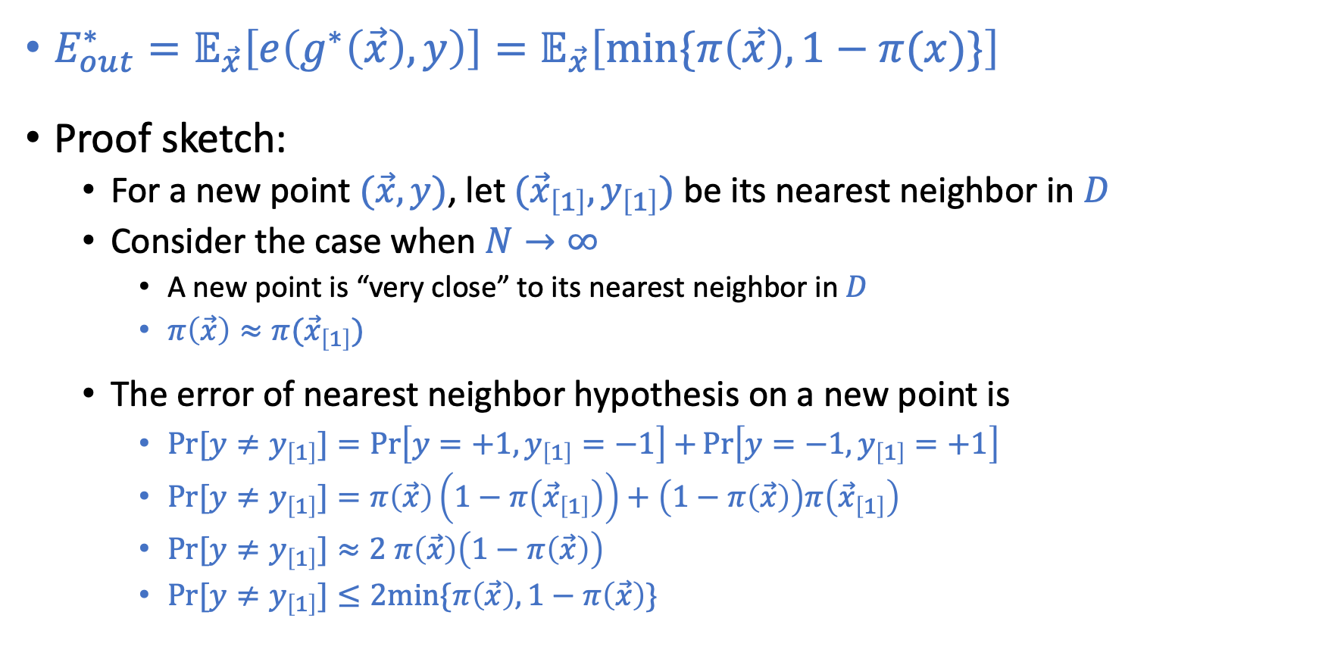
Proof Sketch of 2-Optimality
$E_{out}^{∗}=𝔼_{\vec{x}}\left[e\left(g^{∗}\left(\vec{x}\right),y\right)\right]=𝔼_{\vec{x}}\left[min⁡\{π\left(\vec{x}\right),1−π(x)\}\right]$
Proof sketch:
For a new point $(\vec{x},y)$, let $({\vec{x}}_{\left[1\right]},y_{\left[1\right]})$ be its nearest neighbor in $D$
Consider the case when $N→∞$
A new point is “very close” to its nearest neighbor in $D$
$π\left(\vec{x}\right)≈π({\vec{x}}_{\left[1\right]})$
The error of nearest neighbor hypothesis on a new point is
$\operatorname{Pr}{[y≠y_{\left[1\right]}]}=\operatorname{Pr}\left[y=+1,y_{\left[1\right]}=−1\right]+\operatorname{Pr}\left[y=−1,y_{\left[1\right]}=+1\right]$
$\operatorname{Pr}{[y≠y_{\left[1\right]}]}=π\left(\vec{x}\right)\left(1−π\left({\vec{x}}_{\left[1\right]}\right)\right)+\left(1−π\left(\vec{x}\right)\right)π\left({\vec{x}}_{\left[1\right]}\right)$
$\operatorname{Pr}{[y≠y_{\left[1\right]}]}≈2 π\left(\vec{x}\right)\left(1−π\left(\vec{x}\right)\right)$
$\operatorname{Pr}{[y≠y_{\left[1\right]}]}≤2min⁡\{π\left(\vec{x}\right),1−π\left(\vec{x}\right)\}$
Informal intuitions to summarize the proof:
Assumption for nearest neighbor:
Target function is continuous
That is, nearby points have similar label distributions
As $N$ goes large, there are “close enough” points for prediction

Slide 35
Nearest Neighbor is Self-Regularizing
Intuition of regularization:
Use simpler hypothesis if we don’t have enough data
Nearest neighbor hypothesis The complexity of hypothesis grows with the number of data points

Slide 36
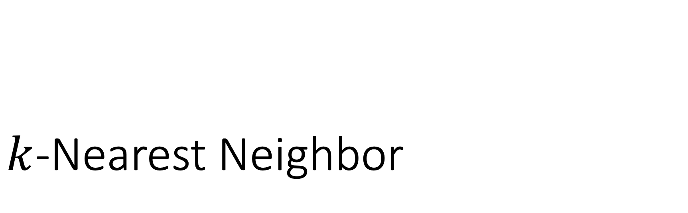
$k$-Nearest Neighbor

Slide 37
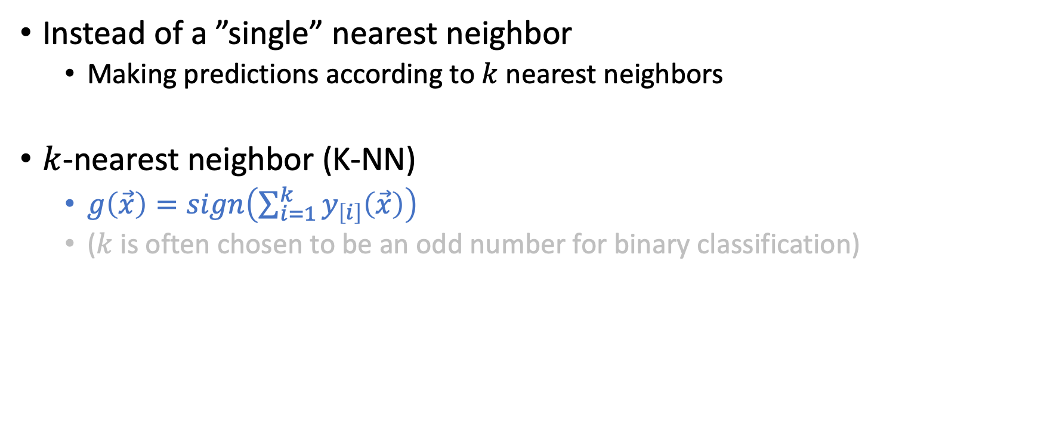
”Stabilize” the Hypothesis
Instead of a ”single” nearest neighbor
Making predictions according to $k$ nearest neighbors
$k$-nearest neighbor (K-NN)
$g\left(\vec{x}\right)=sign\left(\sum_{i=1}^{k}{y_{\left[i\right]}\left(\vec{x}\right)}\right)$
($k$ is often chosen to be an odd number for binary classification)

Slide 38
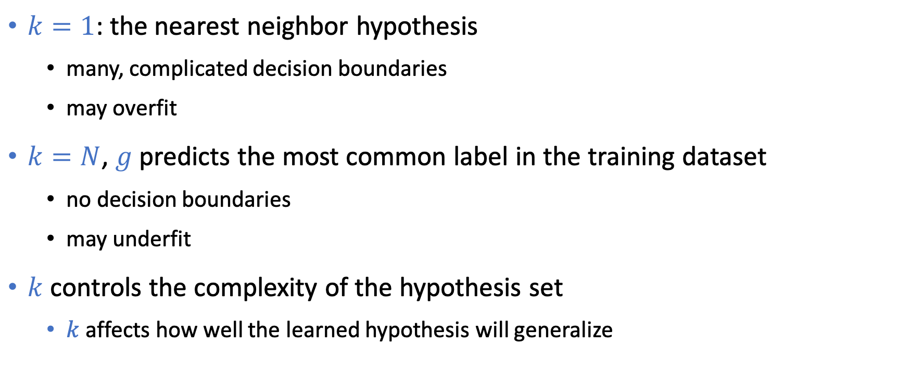
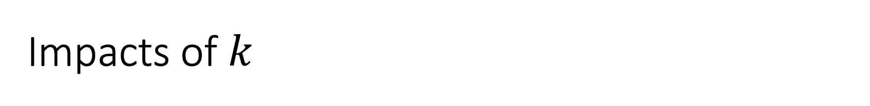
Impacts of $k$
$k=1$: the nearest neighbor hypothesis
many, complicated decision boundaries
may overfit
$k=N$, $g$ predicts the most common label in the training dataset
no decision boundaries
may underfit
$k$ controls the complexity of the hypothesis set
$k$ affects how well the learned hypothesis will generalize

Slide 39
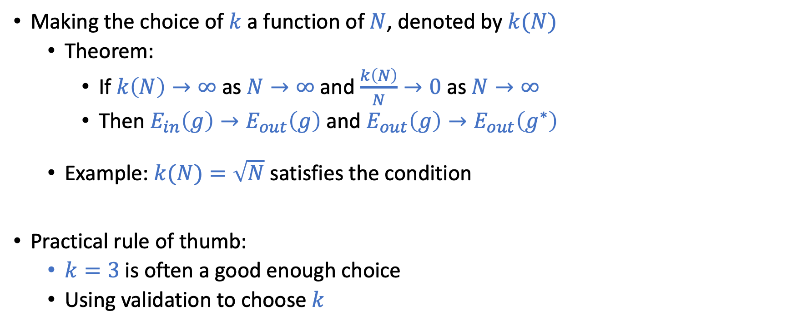
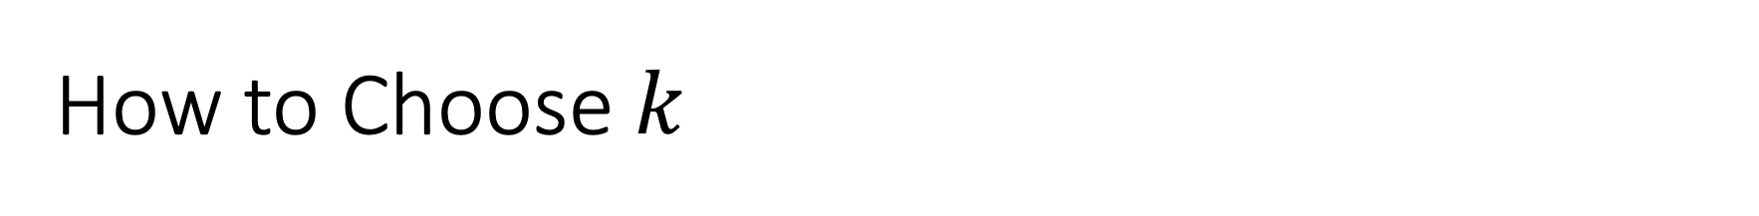
How to Choose $k$
Making the choice of $k$ a function of $N$, denoted by$k(N)$
Theorem:
If $k\left(N\right)→∞$ as $N→∞$ and $\frac{k\left(N\right)}{N}→0$ as $N→∞$
Then $E_{in}\left(g\right)→E_{out}\left(g\right)$ and $E_{out}\left(g\right)→E_{out}\left(g^{∗}\right)$
Example: $k(N)=\sqrt{N}$ satisfies the condition
Practical rule of thumb:
$k=3$ is often a good enough choice
Using validation to choose $k$

Slide 40
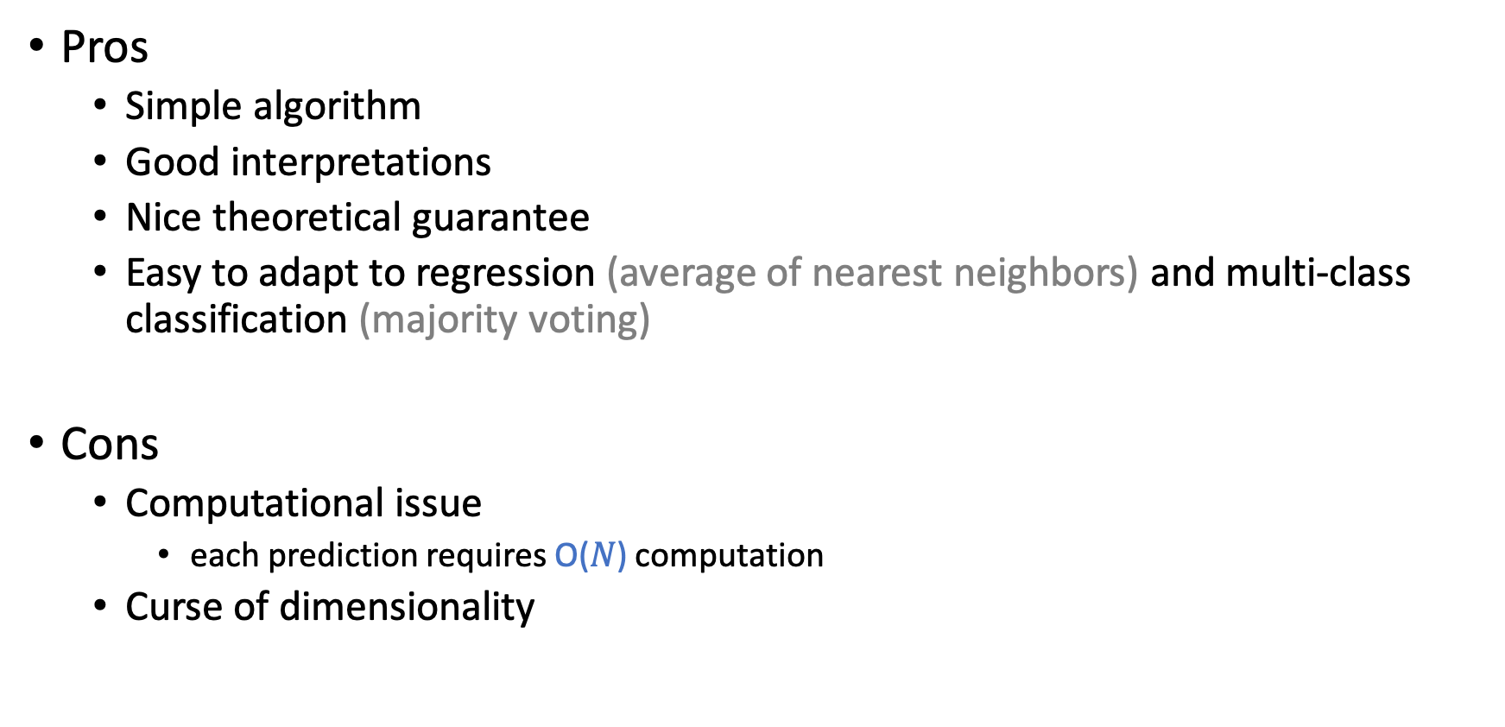
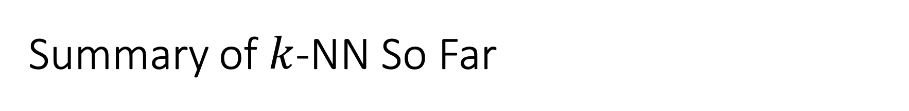
Summary of $k$-NN So Far
Pros
Simple algorithm
Good interpretations
Nice theoretical guarantee
Easy to adapt to regression (average of nearest neighbors) and multi-class classification (majority voting)
Cons
Computational issue
each prediction requires O($N$) computation
Curse of dimensionality

Slide 41
Curse of Dimensionality
Generally, higher dimensions implies harder learning (think VC)
Things are worse with similarity-based methods
that rely on assumptions that points close to one another have similar labels
As the dimension grows, most of the points will not be close to each other…

Slide 42
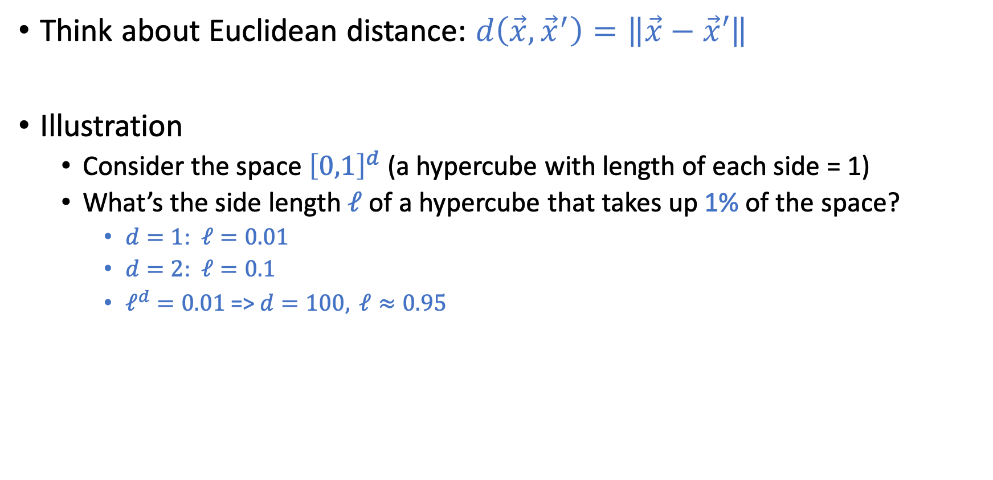
Illustration of Curse of Dimensionality
Think about Euclidean distance: $d\left(\vec{x},{\vec{x}}^{′}\right)=\left\|\vec{x}−\vec{x}′\right\|$
Illustration
Consider the space ${\left[0,1\right]}^{d}$ (a hypercube with length of each side = 1)
What’s the side length $ℓ$ of a hypercube that takes up 1% of the space?
$d=1$: $ℓ=0.01$
$d=2$: $ℓ=0.1$
$ℓ^{d}=0.01$ => $d=100, ℓ≈0.95$

Slide 43
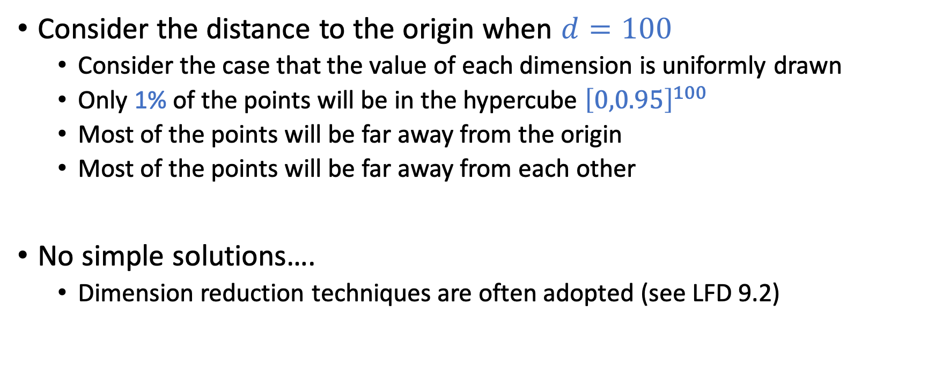
Illustration of Curse of Dimensionality
Consider the distance to the origin when $d=100$
Consider the case that the value of each dimension is uniformly drawn
Only 1% of the points will be in the hypercube ${\left[0,0.95\right]}^{100}$
Most of the points will be far away from the origin
Most of the points will be far away from each other
No simple solutions….
Dimension reduction techniques are often adopted (see LFD 9.2)

Slide 44

Computational Issues
$k$-Nearest Neighbor is computationally demanding
Need to store all data points: space complexity $O(Nd)$
For each prediction for $\vec{x}$
Calculate the distance to every point in $D$
Find the $k$ closest points
Time complexity $O(Nd+Nlogk)$
There are still ongoing research to address this issue
Two general approaches:
Reduce the number of data points
Store the data in some data structure to speed up searching
See LFD 6.2.3 for more discussion

Slide 45
Computational Issues
Reduce the number of data points
Store the data in some data structure to speed up searching

Slide 46
Computational Issues
Reduce the number of data points
Store the data in some data structure to speed up searching
Intuition: remove points that will not impact the decision boundary.
Generally a hard problem. But there are some heuristic approaches.
Intuition: Clustering data points
For a new data point, first find a nearest cluster. Then find the nearest points within that cluster

